Slide 1


MEB1233 – DESIGN THINKING
END SEMESTER PRACTICALS – APRIL/MAY2026
K.RAMAKRISHNAN COLLEGE OF ENGINEERING
Samayapuram (Autonomous)
Department of Mechanical Engineering
(Batch 2024 – 2028)
Year / Sem: II / IV
FINAL REVIEW
Date: 07/05/2026
Project Title: | DESIGN OF SHAFT DRIVEN SYSTEM FOR BIKES
TEAM MEMBERS
ROLL NO | Reg. No | NAME OF THE MEMBER
ME2457 | 8115U24ME057 | SRI KRISHNA S
ME2446 | 8115U24ME046 | RAAJA RISHI P A
ME2438 | 8115U24ME038 | NIRANJAN A R
ME2435 | 8115U24ME035 | MOUNISH S
Course In charge | Designation | Signature
Mr.A.Mohana Krishnan | Asst. Prof

Slide 2
Content
Abstract
Problem Identification
Methods selected for solving problem
Comparison of Modified Design Components
Selection of Modeling Tools
Design and Model of Existing Concept
2D Drawing of New Concept
3D Drawing of new Concept
Advantages of New Concept

Slide 3
ABSTRACT
This project aims to replace the conventional Chain Drive system in 100cc commuter motorcycles with a Zero Maintenance Axial Shaft Drive System. While chain drives are efficient, they require frequent lubrication, cleaning, and tension adjustment, especially in dusty Indian road conditions. By implementing a Bevel Gear-driven Shaft system (similar to premium motorcycles and heavy vehicles), we provide a sealed, durable, and maintenance-free power transmission solution that enhances rider safety and component longevity.
Key Words: Axial Shaft Drive, Power Transmission, Zero Maintanance

Slide 4
PROBLEM IDENTIFICATION
High Maintenance: Standard chains require cleaning and lubing every 500–800 km.
Environmental Impact: Open chain systems are prone to wear due to dust, mud, and rain (common in Indian terrains).
Safety Risk: Sudden chain snapping (Chain cut) can lead to rear-wheel locking and accidents.
Frequent Replacement: A typical 100cc bike chain set lasts only 15,000–20,000 km, leading to recurring costs for the user.

Slide 5
METHODS SELECTED FOR SOLVING PROBLEM
System Redesign: Removing the front and rear sprockets and the drive chain.
Power Diversion: Installing a 90-degree Spiral Bevel Gearbox at the engine output shaft to convert transverse motion to axial motion.
Transmission: Using a lightweight Aluminum 7075-T6 Hollow Shaft to transfer power to the rear wheel.
Flexibility Integration: Incorporating Universal Joints (U-Joints) to allow for rear suspension travel (up and down movement).
Final Drive: Implementing a Crown and Pinion gear set at the rear hub to rotate the wheel.

Slide 6
COMPARISON OF MODIFIED DESIGN COMPONENTS
Component | Existing Design (Chain Drive) | Modified Design (Axial Shaft)
Primary Element | Roller Chain & Sprockets | Hollow Propeller Shaft
Power Transfer | Tension (Pulling) | Torsion (Twisting/Torque)
Lubrication | External (Open to dust) | Internal (Sealed Oil Bath)
Maintenance | Frequent (Tightening/Cleaning) | Zero (Only Periodic Oil Check)
Durability | Low (Approx. 20k km) | High (Approx. 1 Lakh+ km)

Slide 7
SELECTION OF MODELING TOOLS
Modeling (3D): Autodesk Fusion 360 (Ideal for assembly and motion study of gears).
Analysis: ANSYS Static Structural (To check if the Shaft can handle the Engine Torque without shearing).
Drafting (2D): AutoCAD (For precise dimensional layouts of the gear housing).

Slide 8
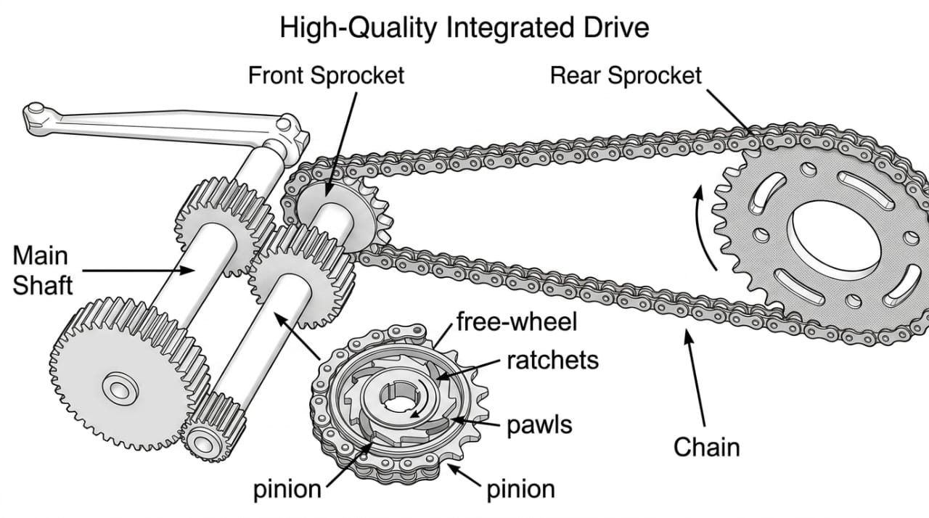
DESIGN AND MODEL OF EXISTING CONCEPT

Slide 9
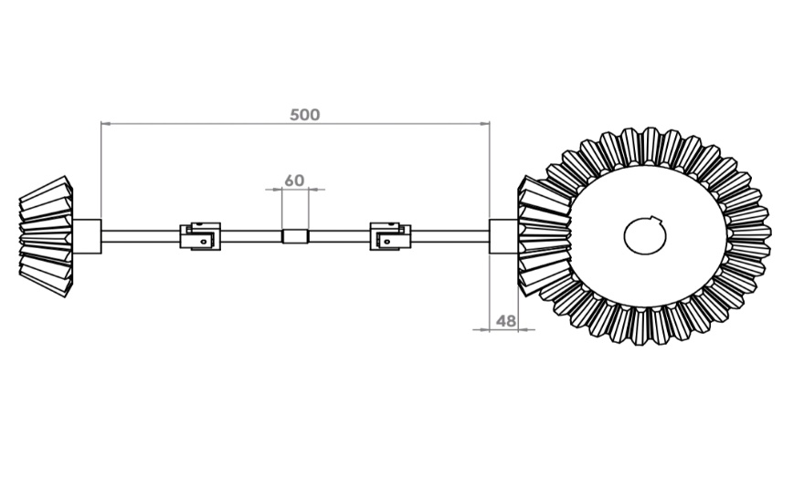
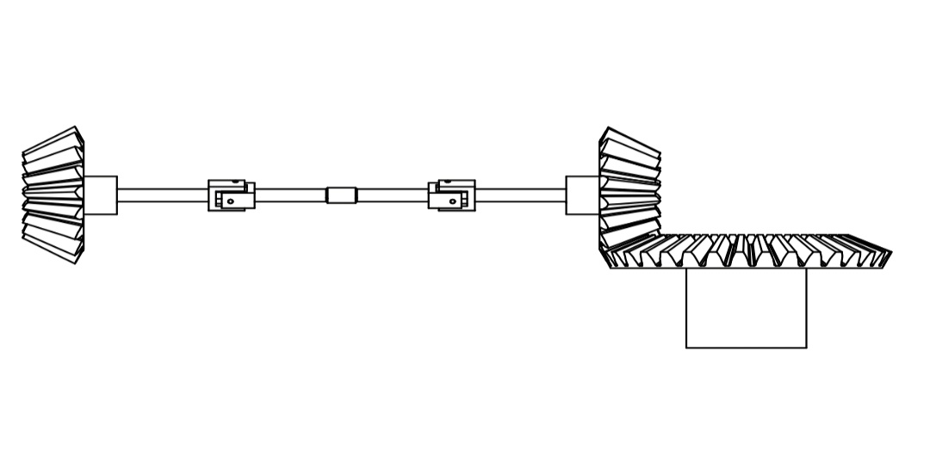
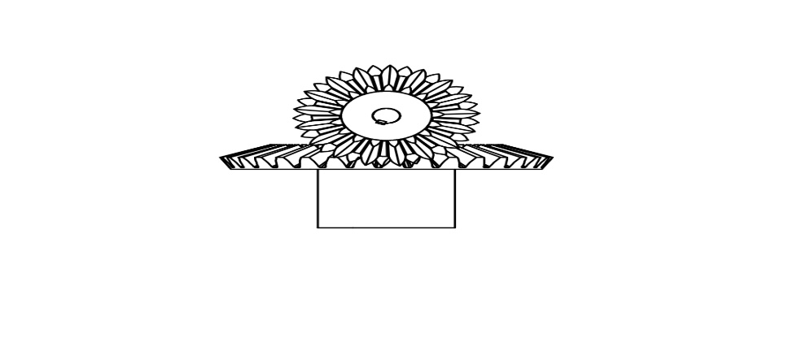
2D DRAWING OF NEW CONCEPT
TOP VIEW
FRONT VIEW
SIDE VIEW

Slide 10
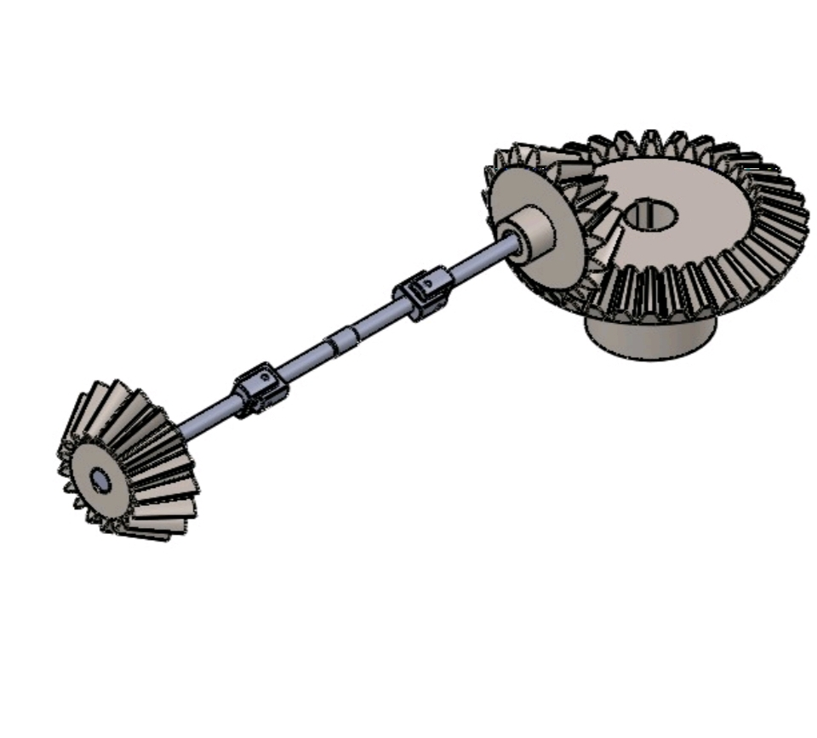
3D DRAWING OF NEW CONCEPT

Slide 11
ADVANTAGES OF NEW CONCEPT OR DESIGN
Reliability: Completely sealed from mud, water, and debris.
Longevity: Gears and shafts outlast chains by 5x to 10x.
User Convenience: No more greasy hands or weekly chain adjustments.
Cleanliness: No oil splatter on the rear wheel rims or the rider’s clothes.
Safety: Zero risk of "Chain Slippage" or snapping during high-speed commutes

